Slide 1
10/10/18 Weekly Meeting Update
Sensors, Processors, Power, Gantt chart

Slide 2
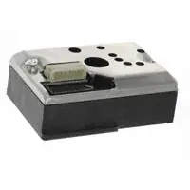
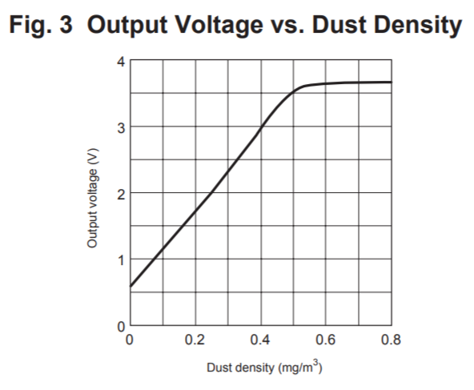
Sensor Update
Application: VOC (need to pick a gas), temperature/pressure/humidity
Research:
Kevin Kelly (sensor disasters) - no response yet
Wettergreen (Rice applications)
Ricardo (worked with VOC sensing before)
Sensors:
VOC: oil spills, natural disasters
Temp/pressure/humidity:
Looked up “temperature, pressure, humidity sensor”
ALL links were to the BME280 (Bosch Sensortec)
Evaluation boards available
Particulates: post-disaster (Hurricane Katrina, 9/11)“shelter cough”
Optical dust sensor (reports density)
Recommended supply 5V, max current 20mA (typical 10mA)
Guideline levels of PM10 (density of 10 μm particulates):
20 μg/m3 annual mean
50 μg/m3 24-hour mean
(from World Health Organization)
(datasheet)

Slide 3
Processor
Talked to Ray, team members → decided to prioritize ease and speed for first prototype
Ordered TI Launchpads for MSP430
Processing capability, low power → viable solution
We are all familiar with CCS, Launchpads for debugging, MSP430s in general
Ordered a development kit for one of the Atmel SAM processors
I will test the hardware and software for this during the semester
Transition can be made over winter break for second prototype
Also got SMT MSP430s, breakout boards, jumpers, etc. for prototyping

Slide 4

Power
Received ~505 and ~570 evaluation boards, batteries, and solar cells
Plan to test charge time indoors/outdoors using each board separately
I’ll make a #niftychart with the data when finished
Need everyone to tell us (Rachel/Brady) power and voltage requirements eventually so we can start finding PMIC or MSP430/Regulators/LDOs
A little birdie told me to try charging with the ICs in parallel

Slide 5
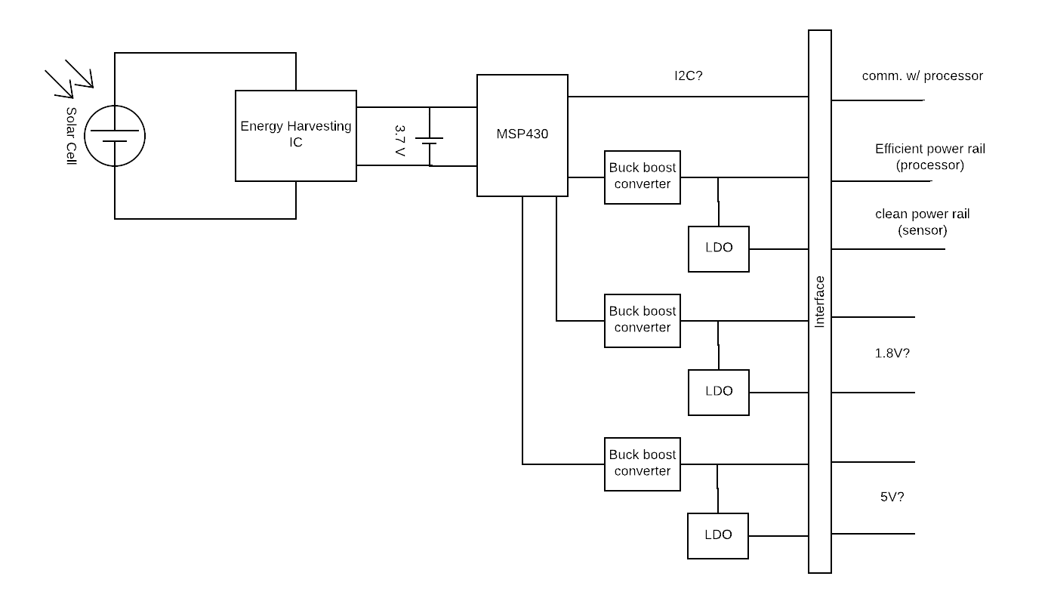
Power Management Board

Slide 6
Gantt Chart

